Slide 1
Video Games Sales Analysis
Pre Placement Project

Slide 2
Table of Contents
About Dataset:
This dataset contains a list of video games with sales greater than 100,000 copies.
Fields include:
Rank - Ranking of overall sales
Name - The games name
Platform - Platform of the games release (i.e. PC,PS4, etc.)
Year - Year of the game's release
Genre - Genre of the game
Publisher - Publisher of the game
NA_Sales - Sales in North America (in millions)
EU_Sales - Sales in Europe (in millions)
JP_Sales - Sales in Japan (in millions)
Other_Sales - Sales in the rest of the world (in millions)
Global_Sales - Total worldwide sales.

Slide 3
Data Cleaning and Preprocessing
Using Python

Slide 4
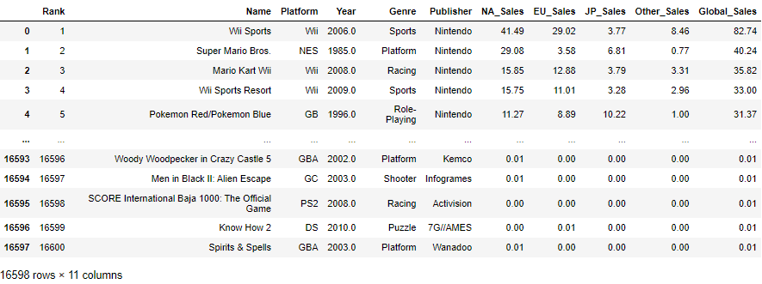
Looking at the data and performing missing value imputation:

Slide 5
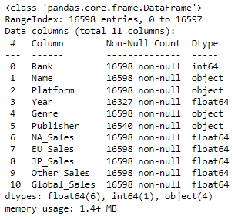
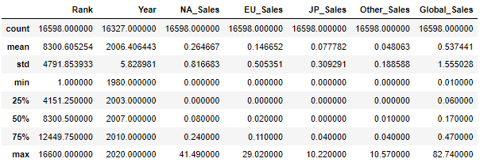
Looking at the data and performing missing value imputation:

Slide 6
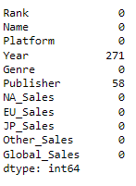
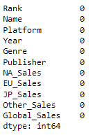
Looking at the data and performing missing value imputation:

Slide 7
Visualizing the Data
Using Tableau

Slide 8
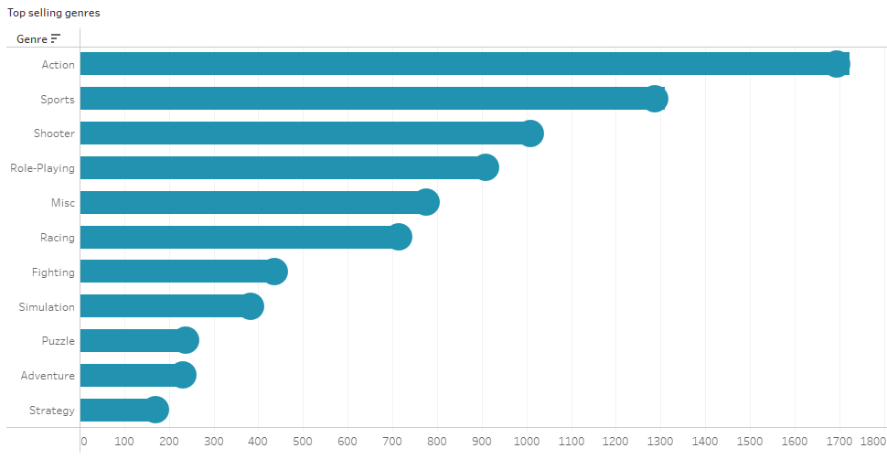
Genre wise Global Sales

Slide 9
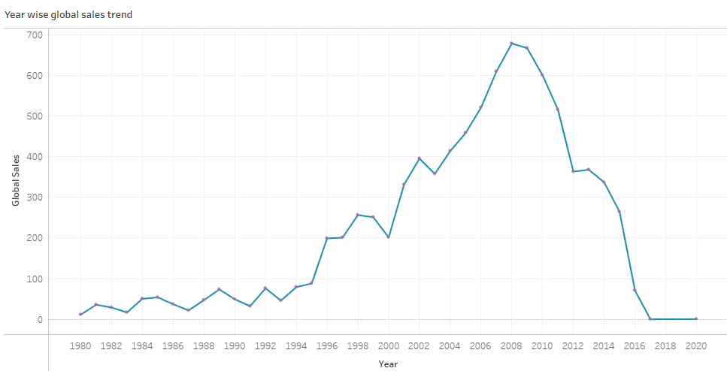
Year wise Global Sales

Slide 10
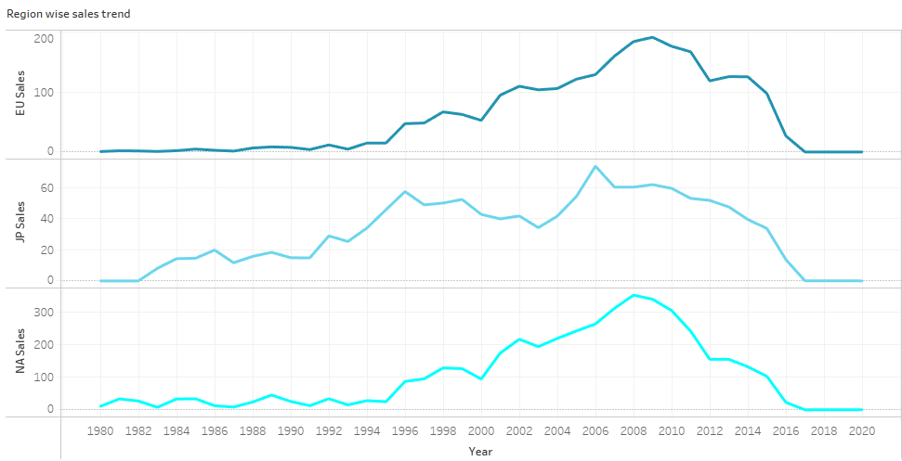
Region wise Sales Trend over the Years

Slide 11
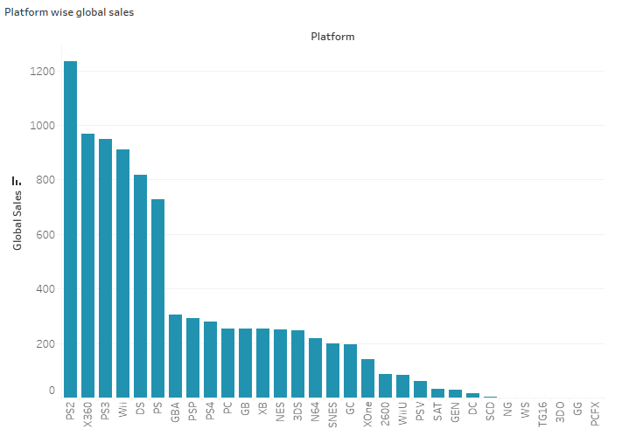
Platform wise Global Sales

Slide 12
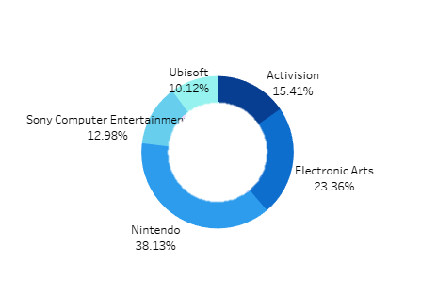
Top 5 Game Publishers

Slide 13
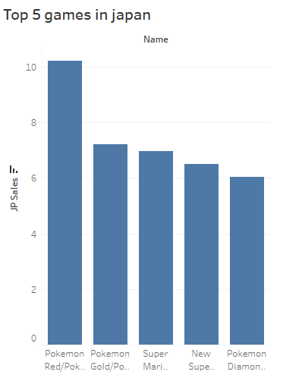
Top 5 Games in Japan

Slide 14
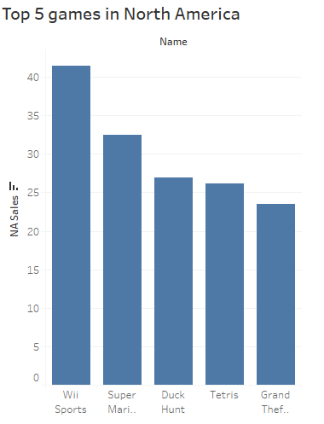
Top 5 Games in North America

Slide 15
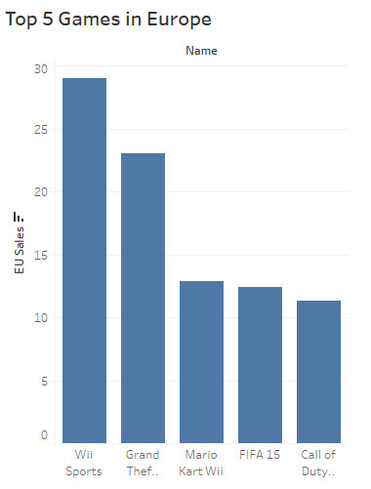
Top 5 Games in Europe

Slide 16
Video Games Sales Analysis Dashboard
Using Tableau

Slide 17
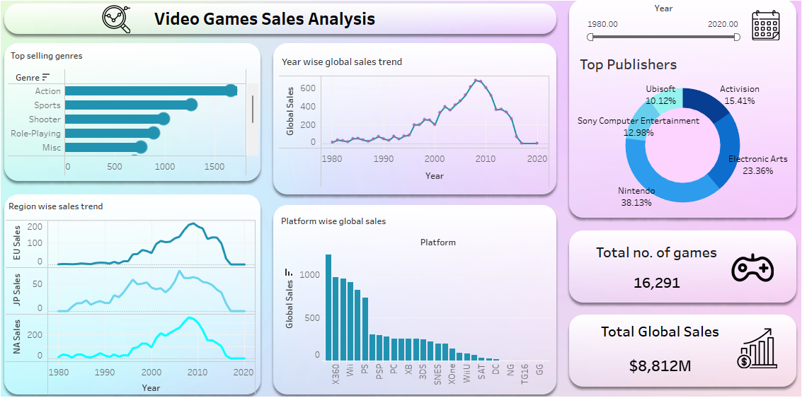

Slide 18
Interpretation

Slide 19
Interpretation:
Top Performing Genres: Based on the analysis, it was found that action, sports, and shooter genres are the most popular and top-performing in terms of sales. Gamers seem to have a strong preference for these types of games, which might be due to their engaging gameplay, competitive nature, and immersive experiences.
Global Sales Peak Years: The years 2008 and 2009 appear to be the most successful for the video game industry in terms of global sales. This could be attributed to various factors such as the release of highly anticipated games, advancements in gaming technology, or effective marketing strategies during those years.
Regional Sales Peaks: The sales trends differ across regions. In Europe, the peak year for sales was 2009, indicating a delayed but substantial growth in the market compared to other regions. In Japan, the peak year was 2006, which suggests that gaming trends and preferences in Japan may have shifted earlier than in other parts of the world. Meanwhile, in North America (NA), the peak year was 2008, highlighting a slightly earlier surge in video game sales compared to Europe.

Slide 20
Interpretation:
Top-selling Platforms: The analysis identifies the PS2, Xbox 360 (x360), PS3, Wii, DS, and PS (PlayStation) as the platforms with games that achieved the highest global sales. These platforms were likely favored by gamers due to their impressive game libraries, hardware capabilities, and popularity among consumers during the period analyzed.
In conclusion, the analysis shows that action, sports, and shooter genres were the most successful in terms of sales. The global video game industry experienced its peak sales in 2008 and 2009, with specific regional variations in sales peaks. The PS2, x360, PS3, Wii, DS, and PS emerged as the platforms driving the highest global game sales.

Slide 21
THANK YOU!

